Slide 1

بِسْمِؔ اللّٰہِ الرَّحْمٰنِ الرَّحِیْمِ
نَحْمَدُہٗ وَنُصَلِّیْ عَلٰی رَسُولِہِ الْکَرِیْم
MS in Project Management

Slide 2

MSP 750 – Project Management Principles and Practices
MS in Project Management

Slide 3
Students Introduction
Name?
Last Qualification?
Profession?
Any Experience in Project Handling?

Slide 4
Instructor
Sajid Mehmood
Bachelors from UoK
MCS from PAF-KIET
MS(PM) from BU(KC)
More than 9 years Administrative Experience
4+ years Teaching and IT Project Handling Experience

Slide 5
Aims
To develop knowledge of the basic principles of project management including best proven practices that are widely applied
Consider contemporary techniques in organising projects and determining high level organisational breakdown structures, Project scope, simple project and task planning, Project Closeout etc.
Consider the functional relationships between time, cost, quality, and change management in the context of Project success criteria
To understand the role of Project Manager in spheres of Project, Organization and Industry in addition to the core competencies he/she possess

Slide 6
Recommended Core Texts
PMBOK 7 & 6 Edition
Project Management: The managerial Process, 6th edition 2014, Clifford F. Gray, Erik W. Larson, McGraw Hill Publications
Guide to the Project Management Body of Knowledge, 6th edition 2017, PMI Inc.
Kerzner.H, (2006) A systems approach to planning, scheduling and controlling. 9th edition. John Wiley, ISBN 0-471-74187-9.

Slide 7
Recommended Texts for background reading
Journals:
International Journal of Project Management
  Association for Project Management (APM) and the International Project Management Association (IPMA)
Project Management Journal
  Project Management Institute® (PMI USA)

Slide 8
Assessment
Marks | Frequency | Marks | Total Marks | Remarks
Quizzes | 4(N-1) | 10 | 20
Assignments | 4 | 2.5 | 10 | Student’s participation in class activities counted in assignments etcetera.
Mid Term | 1 | 30 | 30
Final Paper | 1 | 40 | 40

Slide 9
Time Management
The module is designed to generate 48 hrs of study
Time management is YOUR responsibility
The number of hours of study time required, together with how these are distributed, will depend on YOUR experience

Slide 10
Week 1
Project Management Principles and Practices
The Concept of Project Management

Slide 11
The Concept of Project Management
Contents
Introduction
The history of project management
The project management standards
Summary
Project: Ideas Converting into reality (structured approach)
Trip Planning
Event Planning

Slide 12
Features
Importance
(Why)
Goal Oriented
Temporary (definite Start & End)
Unique (Environment, Budget, Objectives)
Complexity
Resource Management (Time, Money, Technology)
Stakeholder Involvement
Risk & Change Management
Aligned with Objectives (e.g Amazon)
Resource Optimization
Risk Mitigation
Enhanced Communication
Meeting Stakeholders Expectations
Improving Efficiency (SOPs, Best Practices)
Learning & Development

Slide 13
The history of project management
Project management is not new. It has been in use for hundreds of years
Project management is a phenomenon of the twentieth century.

Slide 14
The history of project management
Pyramids of Giza,
Great Wall of China,
Taj Mahal,
Panama Canal,
Development of commercial jet airplanes,
Polio vaccine,
Portable devices to use the global positioning system (GPS), and
Placement of the International Space Station into Earth’s orbit.

Slide 15
Pyramids of Giza,
06 Million Ton total structure
Foot prints 13 Acres
Made up of 2.5 Million tons of Stone Blocks
A piece of Great precision, great skill and great craft

Slide 16
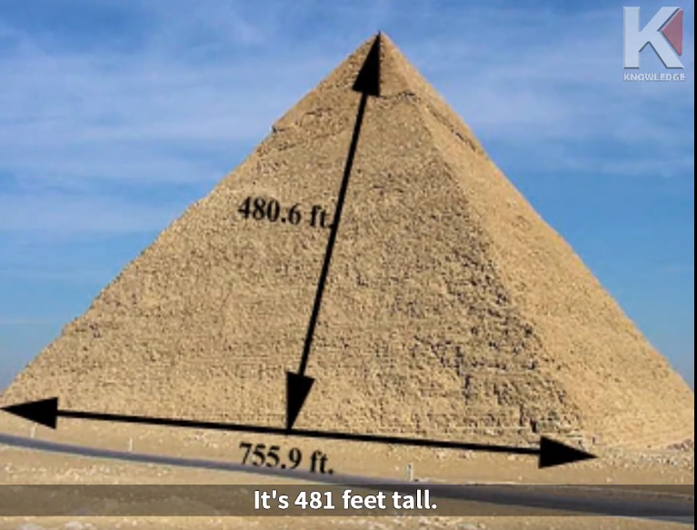
Pyramids of Giza

Slide 17
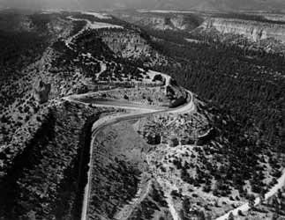
The history of project management
Project management, as a discipline was essentially a spin off from the atomic bomb development program, Project Alamos, in the 1940s. This was the first really complex, high technology project to be operated by mankind.
It was seen that there was a need for a highly dedicated and well- developed team to work together on such projects, in order that the required standards could be delivered on time and within cost.

Slide 18
1.2
The history of project management
The development of several major military projects through the
1950s. Examples:
  the Polaris nuclear submarine fleet for the US Navy
  The Space Shuttle
  Development of “Smart” bombs and missiles
The discipline developed until the Project Management Institute(PMI) in the US and the Association for Project Management (APM) in the UK were formally instituted in the 1960s.
The APM produced its Body of Knowledge in 1988 (regularly updated ), and assisted greatly in the preparation of BS6079 in 1996 and ISO 100006 in 1997.
PM is associated with a particular set of project control tools and techniques – most notably critical path analysis which held back its further development and application to construction.

Slide 19
What is a project?
ISO 8402 defines a project as: (Quality Assurance)
‘A- unique process, consisting of a set of co-ordinated and controlled activities with start and finish dates, undertaken to achieve an objective conforming to specific requirements including constraints of time, cost and resources.’
Gray & Larson (2008) in Project Management: the managerial
process, page 5 defined a project as
‘A complex, nonroutine, one-time effort limited by time, budget, resources, and performance specifications designed to meet customer needs’

Slide 20
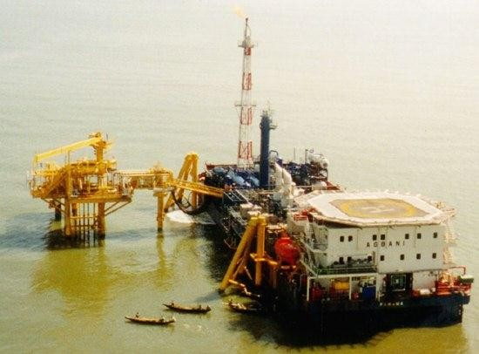
What is a project?
A PROJECT IS NOT ROUTINE REPETITIVE WORK
Project is a unique undertaking: to create to create a unique product, service or result each one will differ from
every other in some respect
A project is an temporary endeavour
projects have specific objectives (or goals) to be achieved

Slide 21
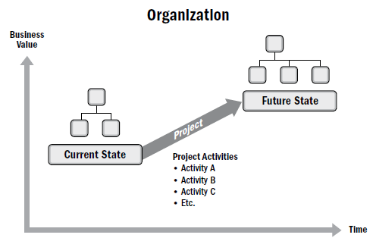
What is a project?
Projects drives change,
Projects takes organizations from one state to another
Projects enables business value creation
Provide both tangible and/or intangible benefits,

Slide 22

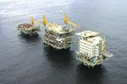

Examples of projects
Major construction projects:
Dubai tower
Jumaira Palm project
Sydney Opera House
The British Library
The Channel Tunnel
Testing and installing a piece of equipment
Developing a new training programme
Establishing a new youth centre
Getting MS PM from BU
Installing a new computer system
Research & development programme

Slide 23
Project Initiation Context
Meet regulatory, legal, or social requirements;
Satisfy stakeholder requests or needs;
Implement or change business or technological strategies; and
Create, improve, or fix products, processes, or services.

Slide 24
WHAT DOES A PROJECT INVOLVE?
Scope
Purpose
Constraints
time]
Budget
Specifications
Resources
Procurement
Contract
Quality control
Safety
Vision
Test
Risk management
Feasibility
Risk assessment
Risk identification
ISO standards
Plan
Control
Value engineering
Variations
Sustainability
Politics
Firing
Hiring
HRM
Finance
Customer Relations
Marketing
Environment
Operations
Leasing
FM
Commissioning
Profit and Loss
Return on investment
Productivity
Regulations
Acceptance by client
Life cycle Maintenance Change mgnt
Close out & handover Liability
Dispute Insurance Certification Logistics Infrastructure Personnel safety Stakeholders Arbitration Statutory
authorities
Cost escalation Legislations Trust Incentives
Work acceleration Maintenance
manuals
As-built drawings
Hazard management
Suppliers
Tendering
Resourcing
Materials
Subcontractors
Design
Negotiations
Security
HSE
Land
Team work
Taxes
Utilities
Social services
Inspection
Surveying
Milestones
NOCs
Service charges
Schedules
QS
Effectiveness
Documentation
Documentation control
Approval
•
•
•
•
Atlerations
Transportation
Cash flows
Claims
Legal issues
Commercial issues
Salaries and Wages Penalties
Strikes Weather Warranties Fraud Damages
Payment & conditions
Bribary Training Mobilisation
•
•
•
•
•
•
•
•
•
•
•
•
•
•
•
•
•
•
•
•
•
•
•
•
•
•
•
•

Slide 25
Group Activity
Consider that you are in need to construct a House for your self.
List down all the areas you will manage/work on, in order to complete the project successfully e.g. Design, Budgeting etc.

Slide 26
Group Activity
Requirement Analysis – Defining my needs, preferences, and lifestyle requirements.
Land Selection & Acquisition – Choosing and purchasing a suitable plot.
Legal Approvals & Documentation – Obtaining necessary permits, approvals, and title verifications.
Budgeting & Financial Planning – Estimating total costs, securing funds, and allocating budget for different phases.
Architectural & Structural Design – Collaborating with architects to create a house plan and structural layout.
Hiring Professionals & Contractors – Selecting architects, engineers, and construction teams.
Material Selection & Procurement – Choosing construction materials, fixtures, and fittings.
Construction Phase – Executing the building process (foundation, structure, roofing, etc.).
Utilities & Infrastructure Setup – Installing water, electricity, gas, and drainage systems.
Interior & Exterior Finishing – Painting, flooring, ceilings, doors, windows, landscaping, etc.
Quality Inspection & Compliance – Ensuring construction meets safety, legal, and quality standards.
Furnishing & Final Touches – Setting up furniture, appliances, and decor.
Handover & Moving In – Finalizing paperwork, taking possession, and moving into the house.
Post-Construction Maintenance – Addressing any issues, repairs, and long-term maintenance plans.

Slide 27
Group Activity
Design and Planning
Budgeting and Finance
Site Selection and Preparation
Construction Management
Materials and Procurement
Project Timeline and Milestones
Legal and Regulatory Compliance
Risk Management
Utilities and Services
Safety and Security
Quality Control and Inspections
Interior Finishes
Landscaping and Exterior Finishes
Utilities Testing and Commissioning
Final Inspections and Approvals
Documentation and Record-Keeping
Warranty and Maintenance

Slide 28
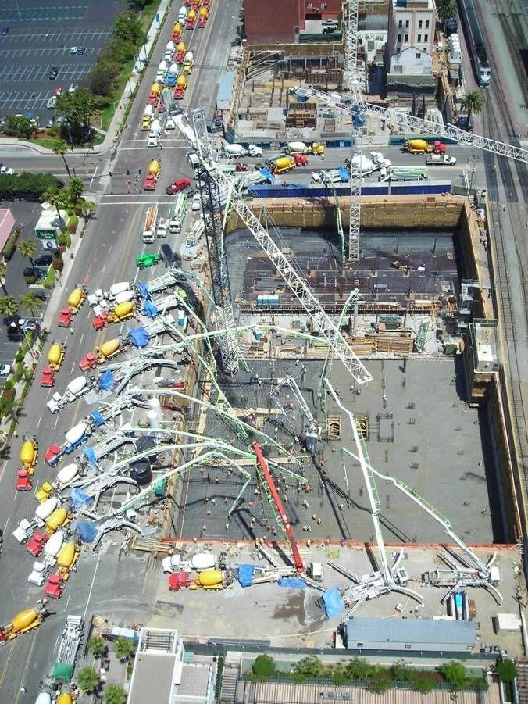

What is Project Management?
‘the application of knowledge, skills, tools and techniques to project activities in order to meet stakeholders needs and expectations from a project’ (APMBoK96)
The art of directing and coordinating human and material resources throughout the life of a project by using modern management techniques to achieve predetermined objectives of scope, cost, time, quality and
participant satisfaction (PMI ‘96)
Project Management is the planning, monitoring and control of ALL aspects of a project and the motivation of all those involved to achieve the project objectives on time
and to cost, quality and performance” (BS 6079)

Slide 29
PMBOK 6TH ed, PMI Knowledge Areas
Project Scope Management
o Plan Scope Management
o Collect Requirements
o Define Scope
o Create WBS
o Validate Scope
o Control Scope
Project Schedule Management
o Plan Schedule Management
o Define Activities
o Sequence Activities
o Estimate Activity Durations
o Develop Schedule
o Control Schedule

Slide 30
Project Cost Management
o Plan Cost Management
o Estimate Costs
o Determine Budget
o Control Costs
Project Quality Management
o Plan Quality Management
o Manage Quality
o Control Quality
Project Resource Management
o Plan Resource Management
o Estimate Activity Resources
o Acquire Resources
o Develop Team
o Manage Team
o Control Resources

Slide 31
Project Communications Management
  Plan Communications Management
  Manage Communications
  Monitor Communications
Project Risk Management
  Plan Risk Management
  Identify Risks
  Perform Qualitative Risk Analysis
  Perform Quantitative Risk Analysis
  Plan Risk Responses
  Implement Risk Responses
  Control Risks

Slide 32
Project Procurement Management
  Plan Procurement Management
  Conduct Procurements
  Control Procurements
Project Stakeholder Management
  Identify Stakeholders
  Plan Stakeholder Engagement
  Manage Stakeholder Engagement
  Monitor Stakeholder Engagement

Slide 33
Project Management Responsibility
Scope
Actions involved in
accomplishing a project
Preference
on time
£ in budget and
 to the specified quality standards
TIME
The Triangle
of Project Objectives

Slide 34


Slide 35
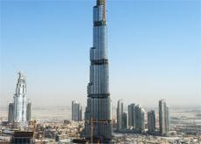
Project Management Success Factors
define project objectives -clearly for all phases
risks – identify, assess and assign
timely decision making – agree / signing off designs / plans prior to the project production phase initiating
project planning – allocate appropriate resources
time & money –
project team – have / build a committed team
control - consider resource requirement
organisational learning – capture and disseminate learning from other projects experience

Slide 36
Project Management Success Factors
contract strategy – consider whether contracts to be used can motivate and identify risks / and reward processes should be made explicit
external environment – ensure that all decision makers are aware of and can accommodate change caused by market circumstances, clients etc
personal development – ensure resource was made available for training, team building, performance appraisal, personal reflection and professional development

Slide 37
Importance of Project Management
Meet business objectives;
Satisfy stakeholder expectations;
Increase chances of success;
Deliver the right products at the right time;
Resolve problems and issues;
Respond to risks in a timely manner;
Optimize the use of organizational resources;
Identify, recover, or terminate failing projects;
Manage constraints (e.g., scope, quality, schedule, costs, resources);
Balance the influence of constraints on the project (e.g., increased scope may increase cost or schedule); and
Manage change in a better manner.

Slide 38

The Project Management Standards
Standard Vs Regulations
Major standards used for project management practice are
Project management practice is anchored on national and international standards.
1. PMI PMBOK
2. BS 6079
3. ISO10006
4. APM Body of Knowledge

Slide 39
APM - Handbook for Project Managers (2004)
Project context
Programme management
Cultural influences
Project success criteria
Strategic Project Plan
Value Management
Risk management
Quality Management
Health, Safety & Environment
Hand-over management
Configuration management
Financial Management
Procurement
Earned Value Management
Design Management
Life Cycle Design Management Post Project Evaluation Review Organisational structures Communication
Teamwork
Project Leadership Conflict Management
Human resource management Work Content & Scope Mgnt Time Scheduling
Resource Management Budget & Cost Management
Change Control Information Management

Slide 40
Project Manager
Increasingly, the project manager is specifically qualified and experienced in project management.
He or she is in charge of the project team and is responsible for the successful conclusion of the project.

Slide 41
Project Sponsor
BS6079 indicates that this is an individual or body for whom the
project is undertaken and who is the main risk taker.
The project sponsor can be thought of as the client organisation
(s)
can also be the individual representing the client organisation / sponsoring body and to whom the project manager reports

Slide 42
Stakeholders & Others
Are those who have the potential to influence the course of a project.
They can be members of the project team and so be the direct parties to a contract.
Can also be indirect in that they are part of the community in which the project is situated.
The statutory / planning system in place in the project location can also be indirect stakeholders in that they can have influence over the project.

